Slide 1

Urine production
https://www.womensrunning.com/wp-content/uploads/sites/2/2018/11/Photo-credit_-Scott-Rokis-2.jpg
Designed by: Justin Shaffer
www.recombinanteducation.com

Slide 2
Learning Objectives
Compare and contrast filtration, secretion, reabsorption, and excretion in terms of function and location
Explain how filtration occurs through the renal corpuscle and predict how it is affected by various stimuli
Explain how reabsorption and secretion along the length of the nephron and the countercurrent multiplier produce urine and predict how they are affected by various stimuli
Explain and predict how hormones regulate urine volume and composition

Slide 3
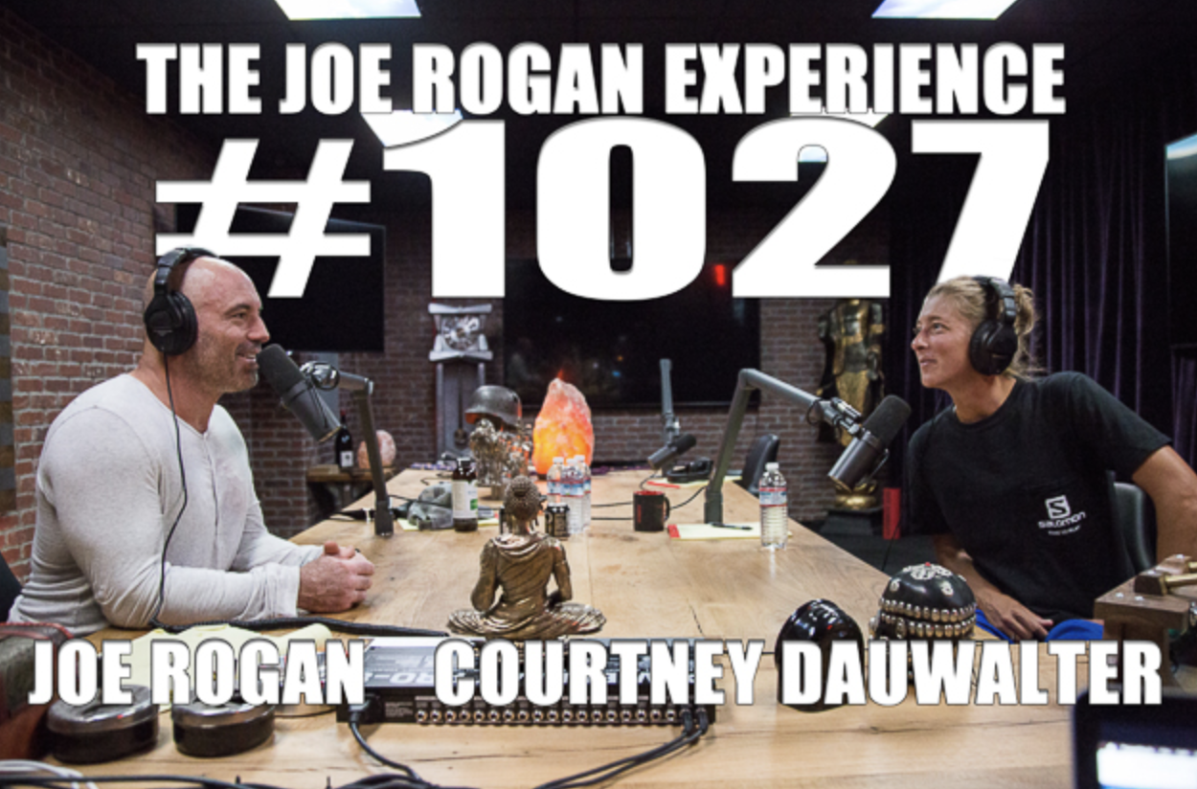
PodCase: Salt and the kidneys
Credit: Spotify

Slide 4

Courtney Dauwalter
Ultramarathon runner
Used to live and train in Golden, CO - now based in Leadville
Taught high school science in Denver
Won the inaugural Moab 240 (miles!) in 2017 in 57:55:13
In 2023 became first person to win Western 100, Hardrock 100, and UTMB all in same year!
Loves to eat candy and nachos
https://www.salomon.com/sites/default/files/styles/crop_article_illustration/public/2019-09/courtney_dauwalter_running.jpg?itok=lhOiRdbP

Slide 5
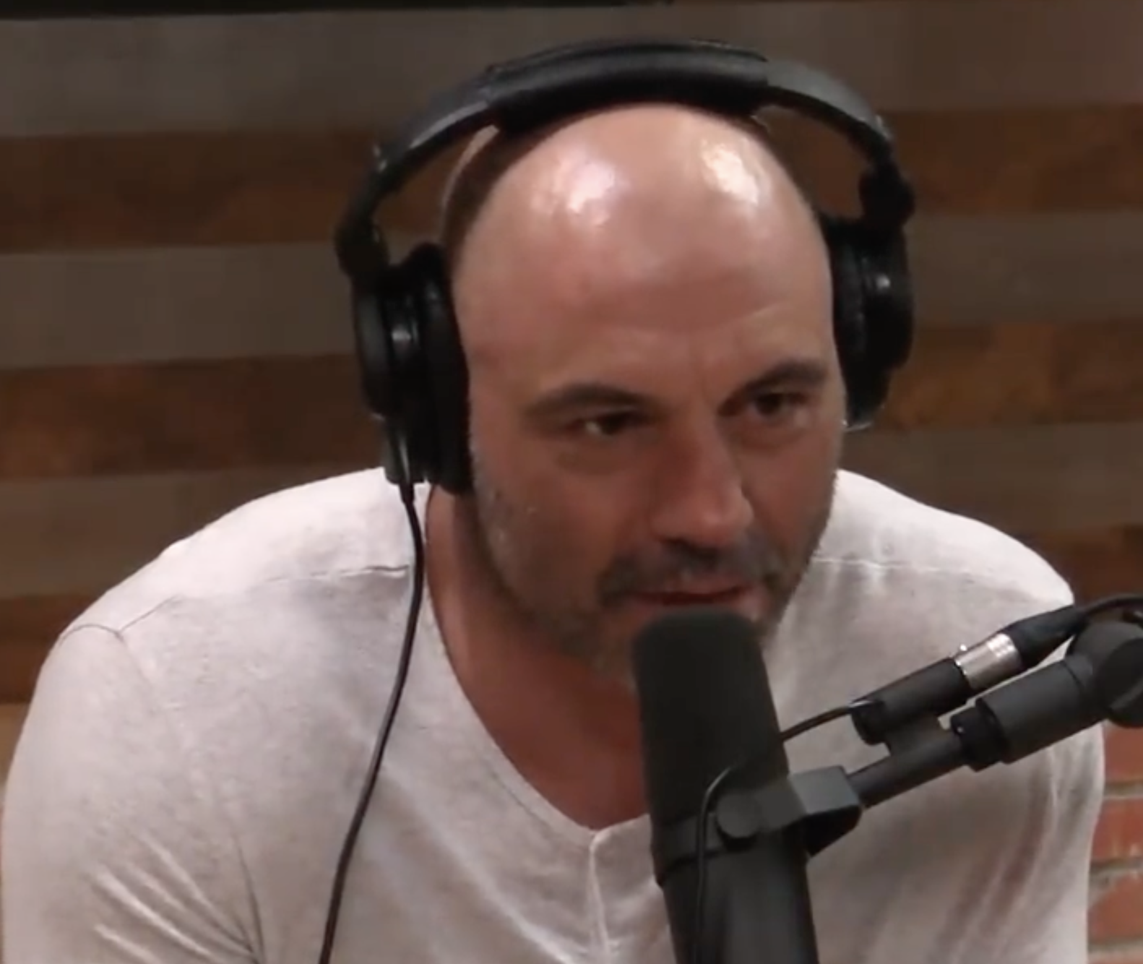
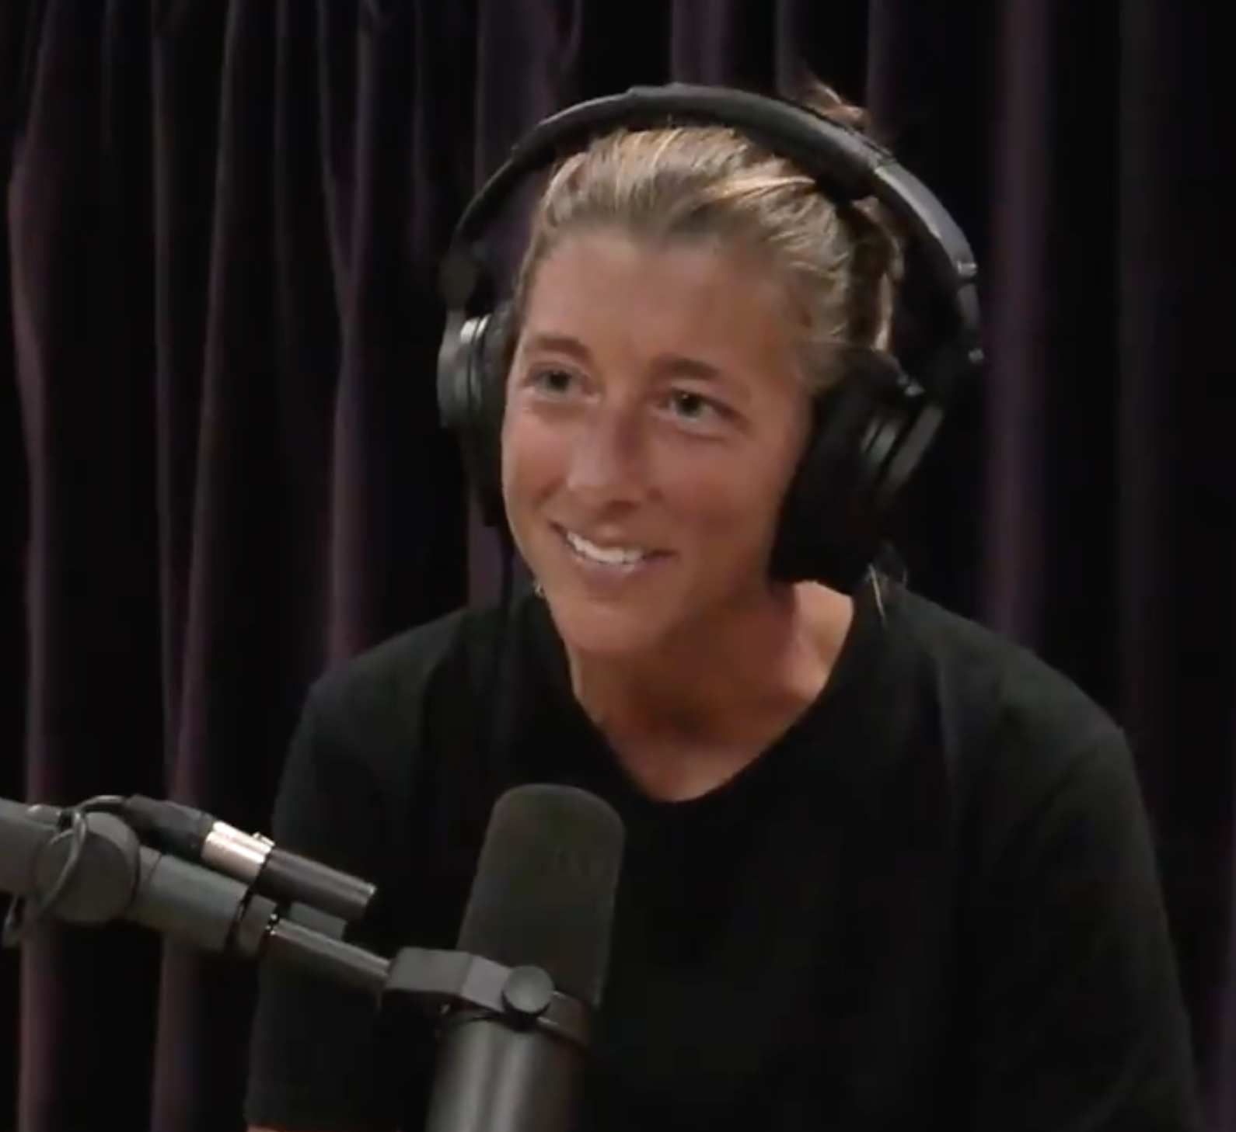
Credit: Spotify
Play from 0:30:04 to 0:31:58
Link to full episode:
https://open.spotify.com/episode/06hcR2fHwIl3DZWDiiCWmD?si=8e27b3359b8b48f4
How do the kidneys make urine?

Slide 6
Where do filtration, reabsorption, and secretion take place in the nephron?
Renal corpuscle
Proximal convoluted tubule
Descending loop of Henle
Ascending loop of Henle
Distal convoluted tubule
Collecting duct
F
R, S
R
R
R, S
R, S
What gets transported in each region? Let’s walk through each region one at a time…

Slide 7
https://en.wikipedia.org/wiki/Nephron

Slide 8
In the renal corpuscle, blood colloidal osmotic pressure is 25 mmHg, capsular hydrostatic pressure is 13 mmHg, and glomerular hydrostatic pressure is 52 mmHg. What will occur and why?
A – Filtrate will move from the glomerulus to Bowman’s capsule because NFP is negative
B – Filtrate will move from the glomerulus to Bowman’s capsule because NFP is positive
C – Filtrate will move from Bowman’s capsule to the glomerulus because NFP is negative
D – Filtrate will move from Bowman’s capsule to the glomerulus because NFP is positive

Slide 9
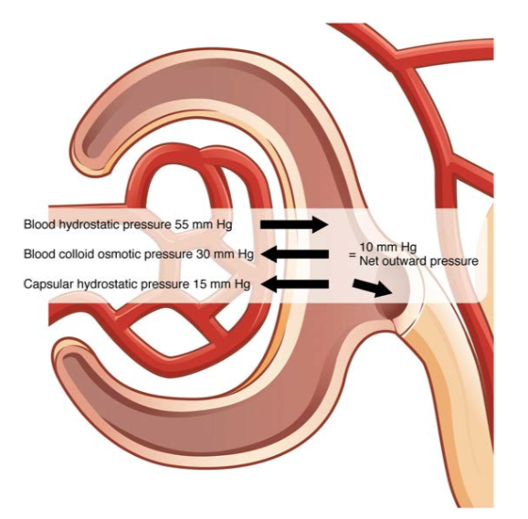
Bowman’s capsule
What contributes to each of these pressures?
Glomerulus
Credit: OpenStax

Slide 10
What statement is FALSE about the proximal convoluted tubule?
A – Water is reabsorbed from the PCT
B – Sodium passively diffuses from the PCT to the peritubular capillaries
C – Hydrogen ions are secreted into the PCT
D – The PCT is the most active region of the nephron for reabsorption and secretion

Slide 11
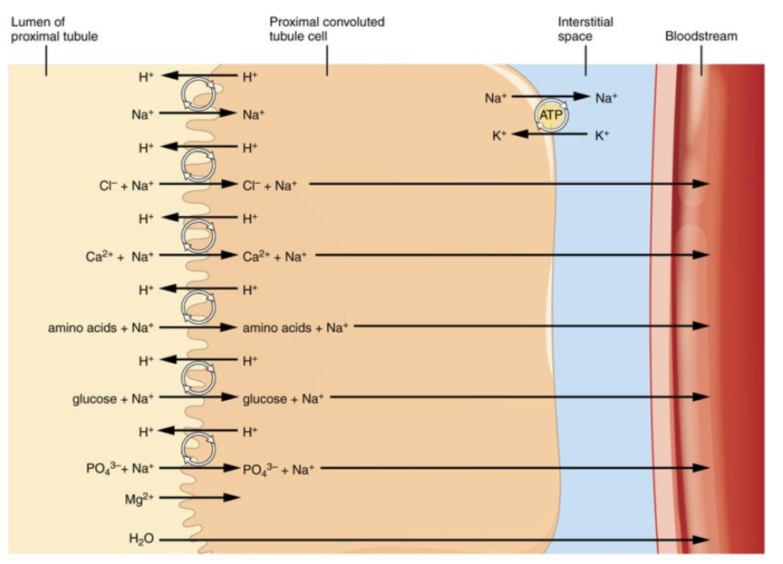
Credit: OpenStax

Slide 12
Which statement about the loop of Henle is FALSE?
A – The ascending limb actively transports sodium and chloride out of the nephron cells
B – The descending limb and ascending limb are both permeable to water
C – Filtrate leaving the ascending limb is more dilute than filtrate entering the descending limb
D – Osmosis cannot occur in the ascending limb
E – Osmolarity increases as you move “down” the descending limb

Slide 13
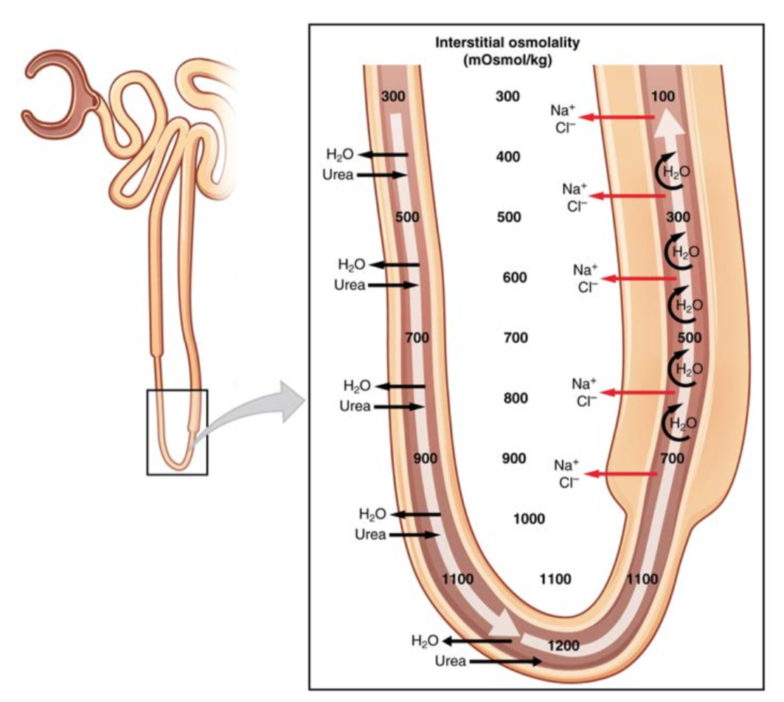
Explain how the osmotic gradient is produced
Credit: OpenStax

Slide 14
What statement is FALSE about the distal convoluted tubule and collecting duct?
A – Water is reabsorbed from the DCT and from the collecting duct
B – Calcium ions are reabsorbed from the DCT
C – Sodium ions are secreted into the DCT from the peritubular capillaries
D – The collecting duct is sensitive to ADH
E – The major functions of the collecting duct are to regulate urine volume and osmolarity

Slide 15
During a race Courtney was losing too much sodium through sweat and was at risk for dehydration and thus needed to take salt tabs. What is her body’s response to low sodium levels?
A – ADH levels decrease and aldosterone levels decrease
B – ADH levels increase and aldosterone levels decrease
C – ADH levels increase and aldosterone levels increase
D – ADH levels decrease and aldosterone levels increase

Slide 16
https://en.wikipedia.org/wiki/Nephron#/media/File:Kidney_nephron_molar_transport_diagram.svg

Slide 17
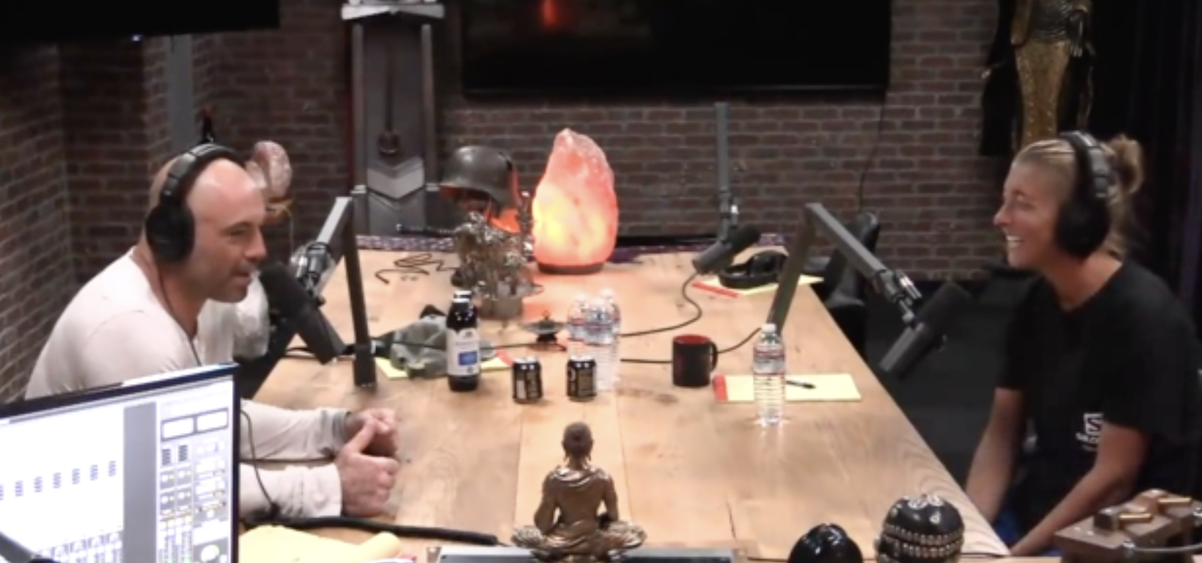
What happened to Courtney during the Run Rabbit Run race in Steamboat, CO in 2016?
Credit: Spotify
Play from 0:45:10 to 0:46:40
Link to full episode:
https://open.spotify.com/episode/06hcR2fHwIl3DZWDiiCWmD?si=8e27b3359b8b48f4

