Slide 1

Synapses and Transmission
https://www.nexusnewsfeed.com/article/health-healing/amanda-feilding-has-spent-54-years-experimenting-with-psychedelics-for-the-sake-of-science/

Slide 2
Learning Objectives
Compare and contrast excitatory and inhibitory postsynaptic potentials and temporal and spatial summation
Identify the structures of and explain the events that occur during chemical synaptic transmission
Describe the functions of common neurotransmitters and identify them as primarily excitatory or inhibitory

Slide 3
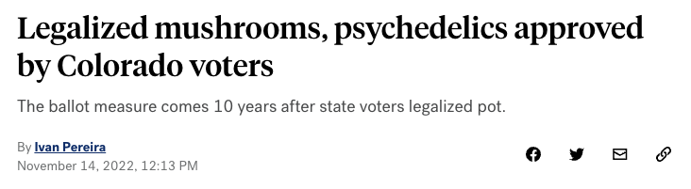

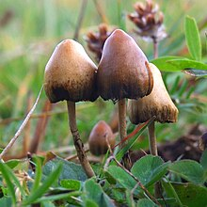
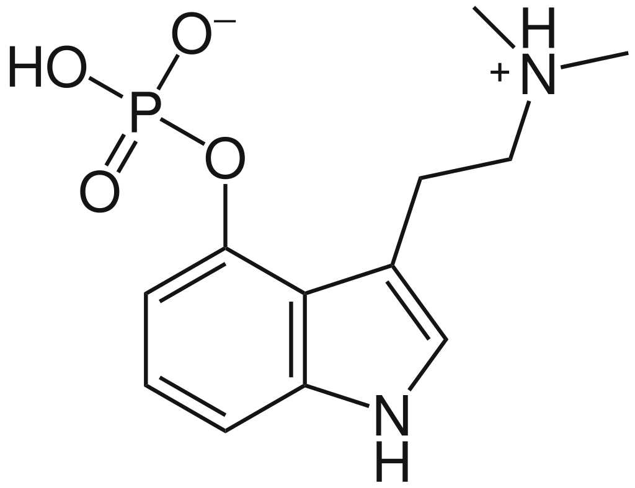
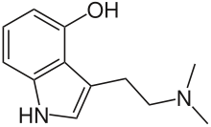
metabolized by liver to
Psilocybin
https://en.wikipedia.org/wiki/Psilocybin
https://en.wikipedia.org/wiki/Psilocybin_mushroom
Psilocybe semilanceata
Psilocin
https://en.wikipedia.org/wiki/Psilocin

Slide 4
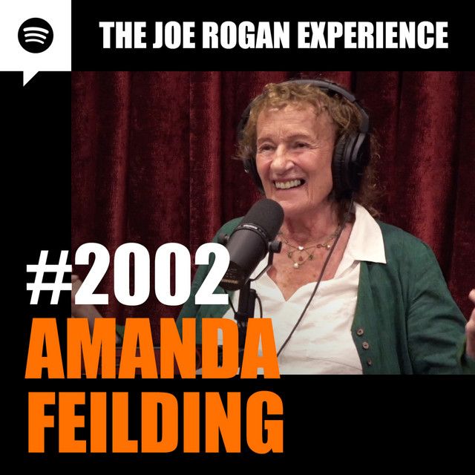
PodCase: Neuron synapses
Credit: Spotify

Slide 5

Amanda Feilding
Founder of the Beckley Foundation which supports neurological research on the use of psychedelics for the treatment of mental health disorders including depression, anxiety, and addiction
Also studies the effects of cannabis and LSD on mental health
https://www.beckleyfoundation.org/amanda-feilding/
https://www.beckleyfoundation.org/

Slide 6
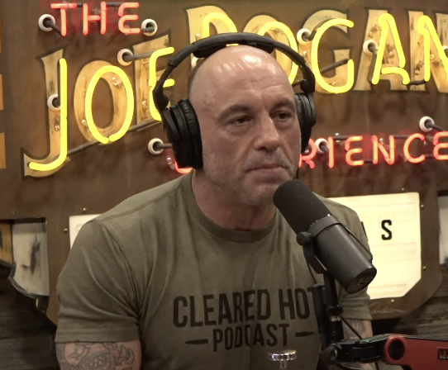
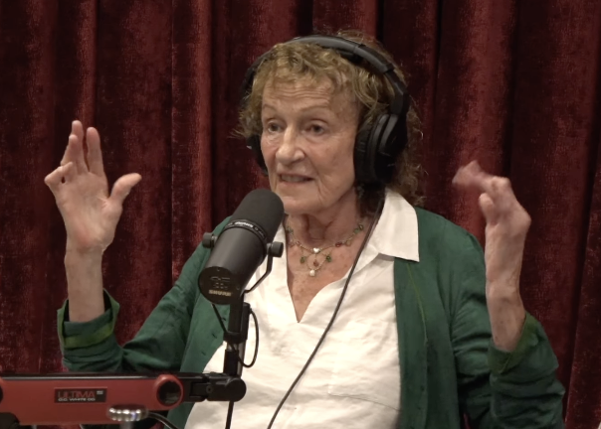
Credit: Spotify
Play from 1:09:10 to 1:11:20
Link to full episode:
https://open.spotify.com/episode/04O1q0t4aBhLLYgcZpT7TM?si=nvOr15r9TlyYwKIJAPjyAw
How do neurons communicate?

Slide 7
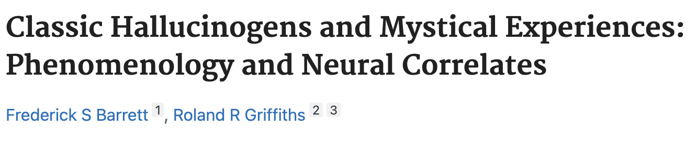
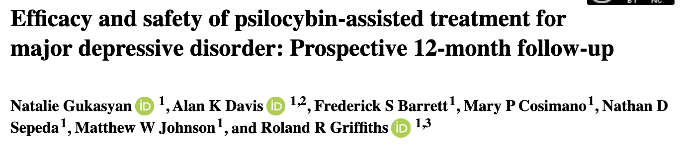
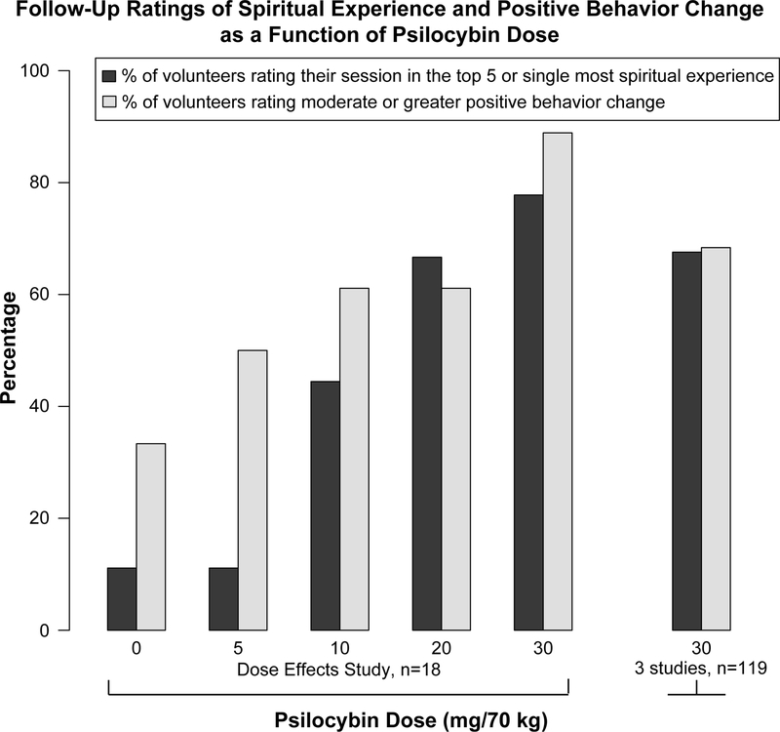
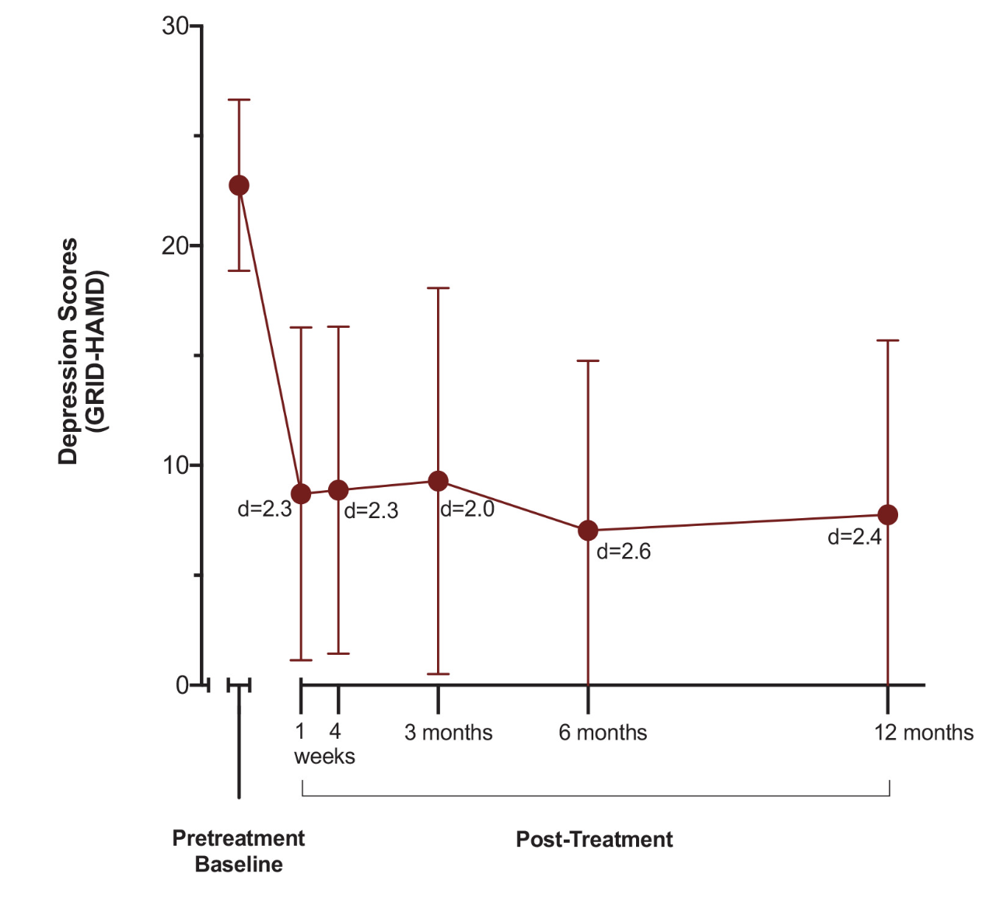
https://pubmed.ncbi.nlm.nih.gov/28401522/
https://journals.sagepub.com/doi/full/10.1177/02698811211073759

Slide 8
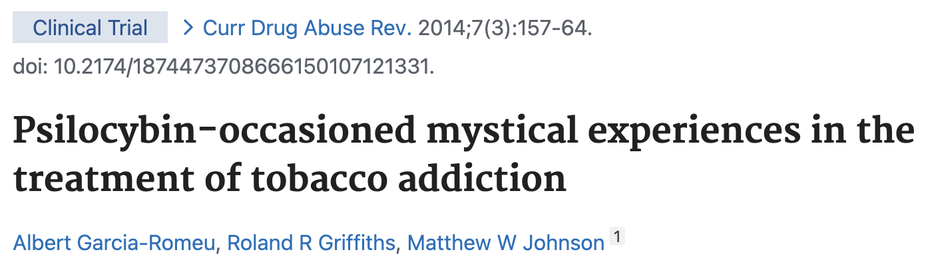
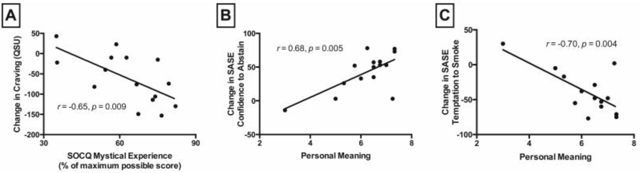
How does psilocin work?
https://pubmed.ncbi.nlm.nih.gov/25563443/

Slide 9
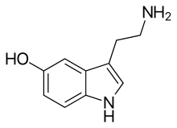
What does psilocin look like?
Serotonin
Psilocin
https://en.wikipedia.org/wiki/Psilocin
https://en.wikipedia.org/wiki/Serotonin
What do you think psilocin does?
Acts as an agonist to serotonin and influences serotonin’s effects in the synaptic cleft

Slide 10
What happens at the synapse?
Put events in correct order
A – Depolarization opens voltage-gated calcium channels
B – Neurotransmitters bind to receptors on postsynaptic neuron
C – The signal is terminated
D – An action potential signal from a presynaptic axon arrives at synaptic terminals
E – Neurotransmitters are released into synaptic cleft
DAEBC

Slide 11
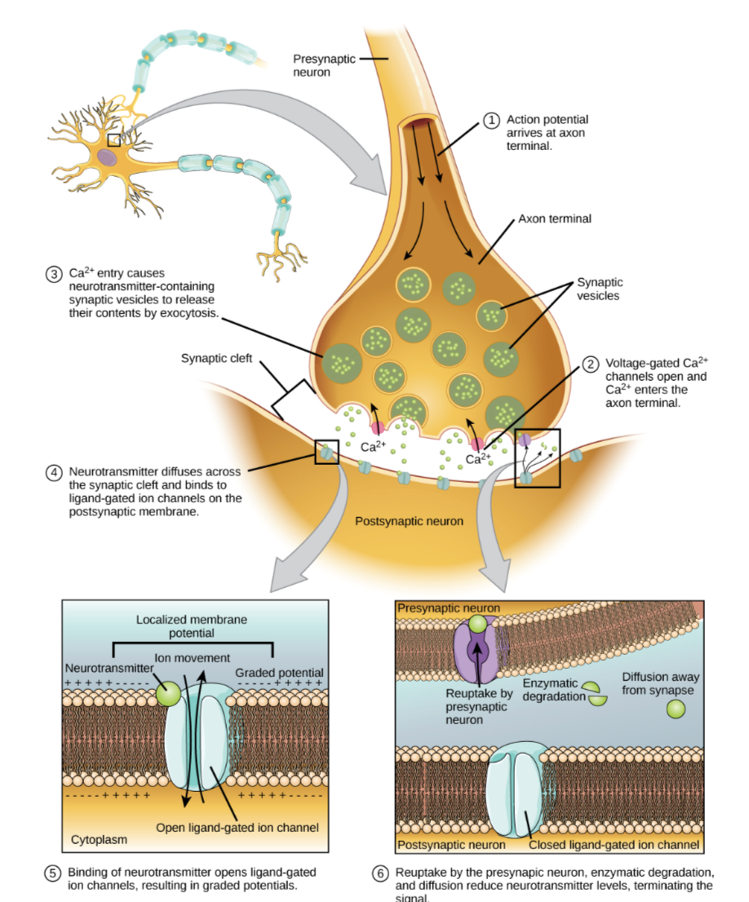
What are two ways that the signal can be terminated?
Enzymatic breakdown
Reuptake by transporters
Credit: OpenStax

Slide 12
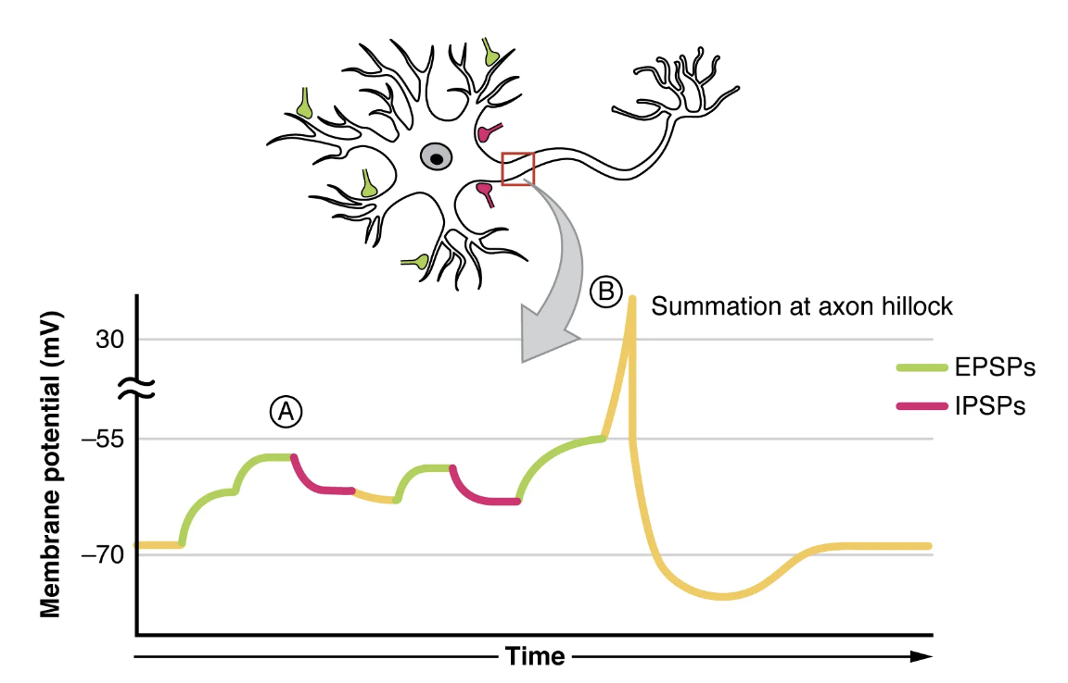
What best explains what is happening in the green regions of the graph?
A – Depolarizations occur due to summation of EPSPs
B – Hyperpolarizations occur due to summation of EPSPs
C – Depolarizations occur due to summation of IPSPs
D – Hyperpolarizations occur due to summation of IPSPs
Credit: Openstax

Slide 13
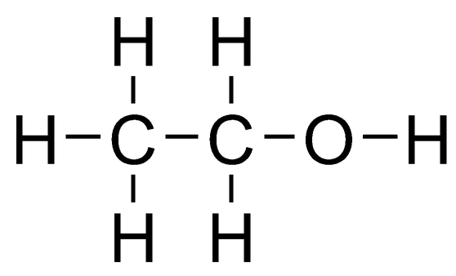
What would happen if a drug caused GABA’s effects to be magnified?
A – Fewer IPSPs would be generated
B – More IPSPs would be generated
C – Fewer EPSPs would be generated
D – More EPSPs would be generated
This is how alcohol works!
http://learn.genetics.utah.edu/content/addiction/mouse/

Slide 14
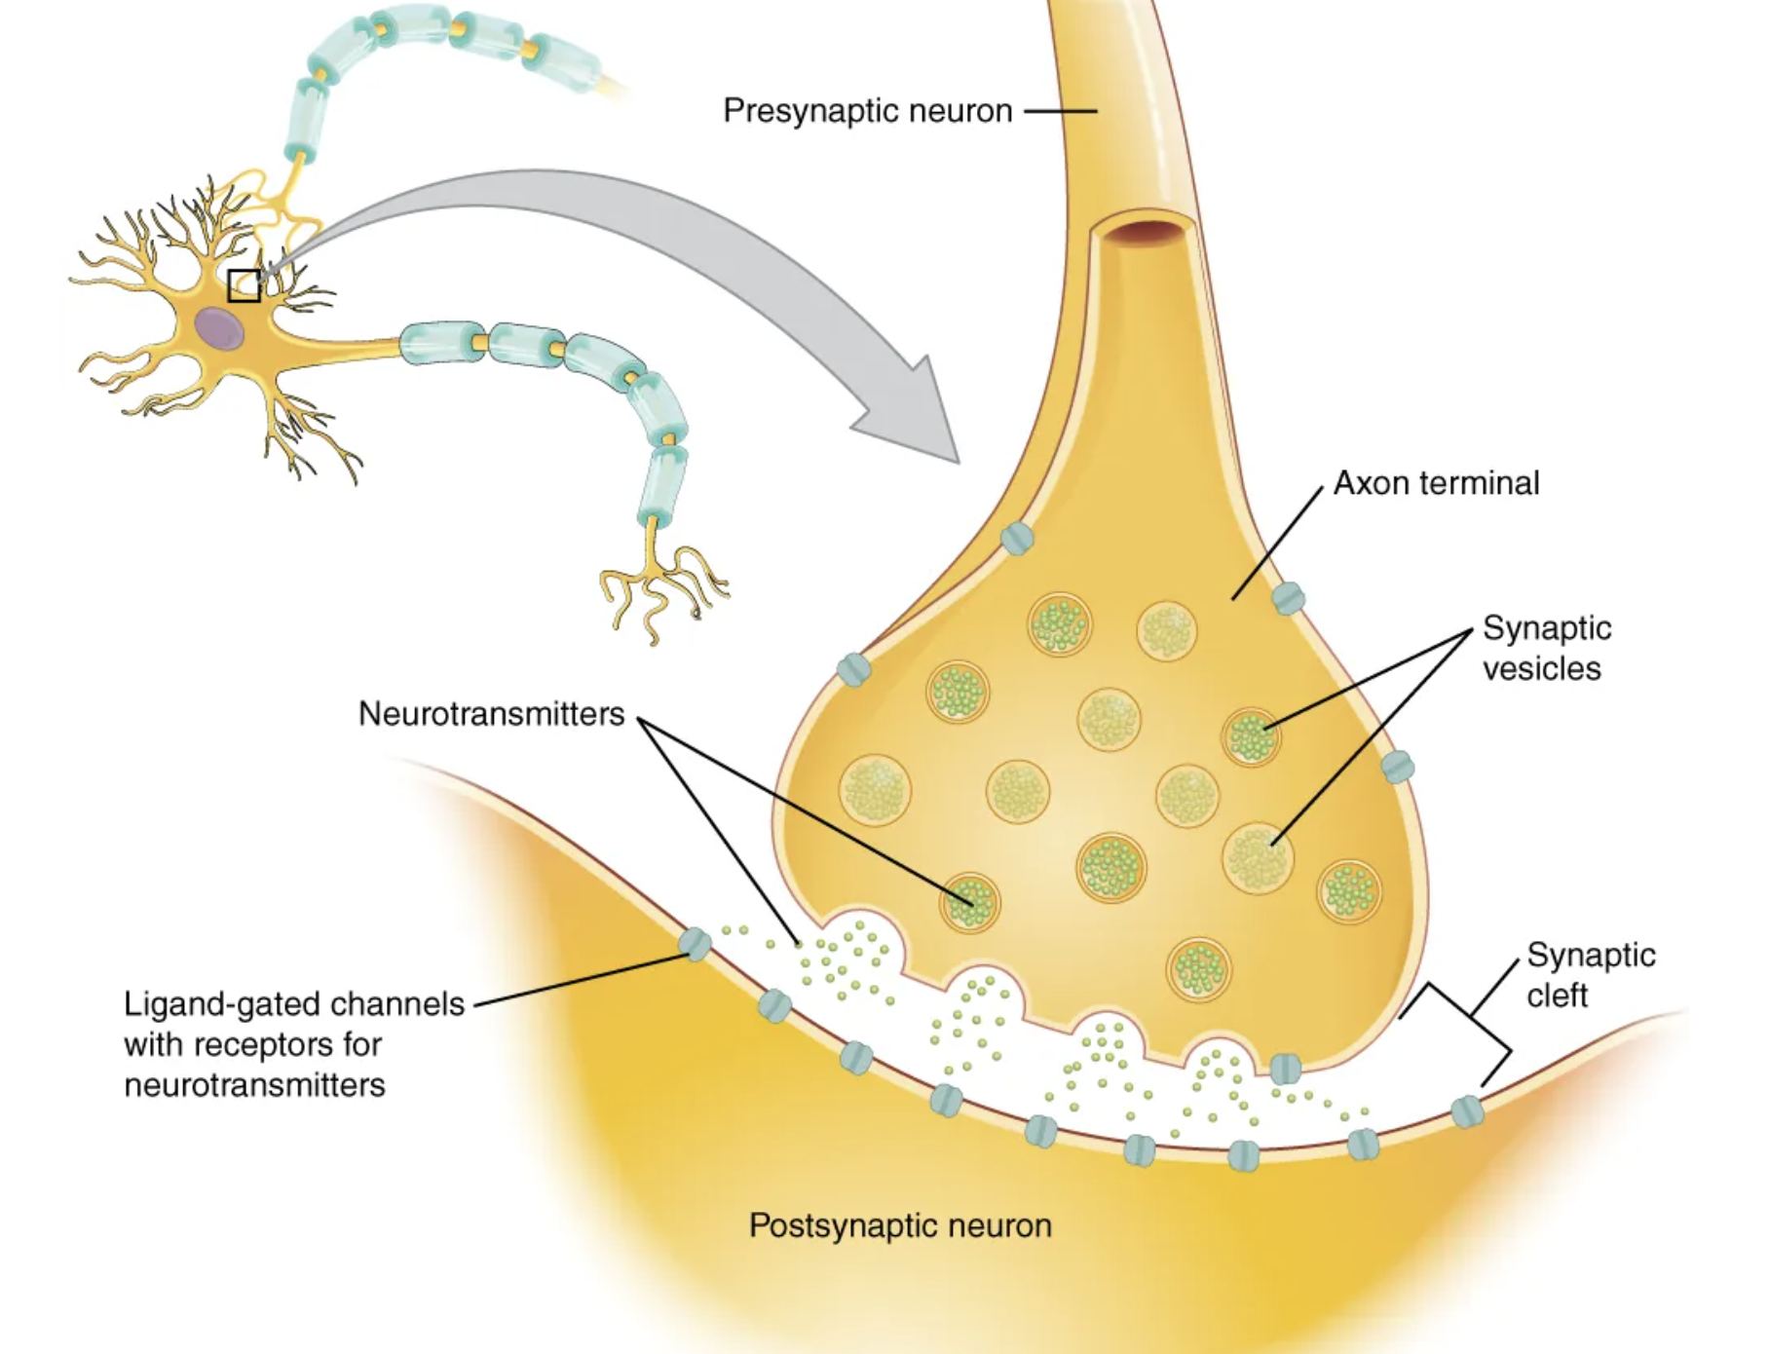
Psilocin acts as a serotonin agonist. Where would psilocin act on this diagram?
Credit: Openstax

Slide 15
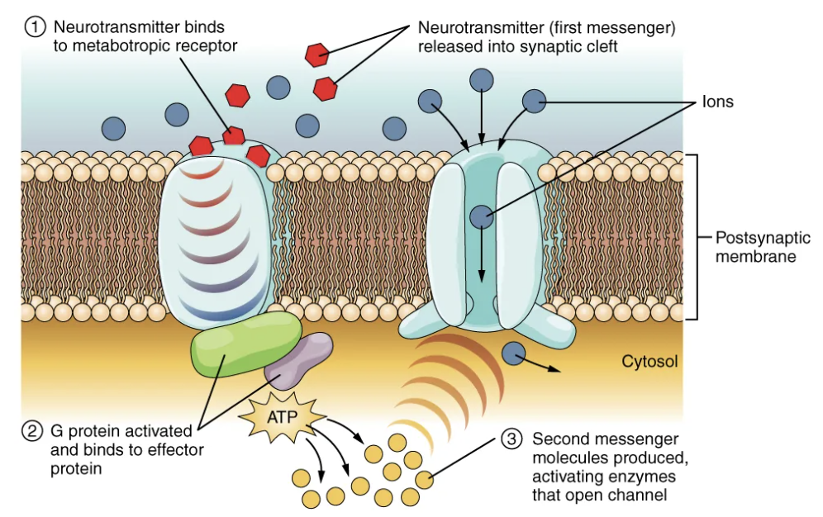
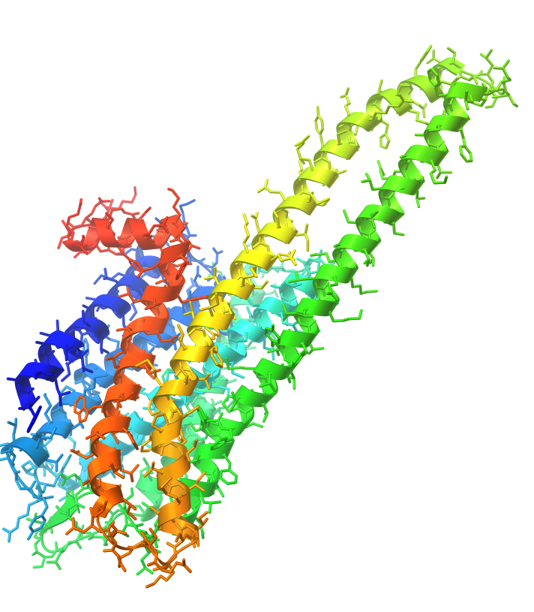
Credit: Openstax
Specifically, psilocin targets the serotonin 5-HT_{2A} receptor, which is a type of GPCR
Activation of 5-HT_{2A} → hallucinogenic effects
https://en.wikipedia.org/wiki/5-HT2A_receptor

Slide 16
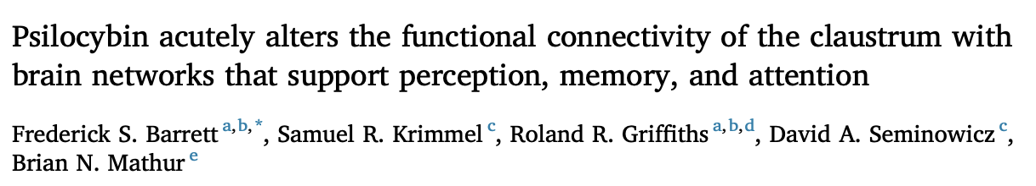
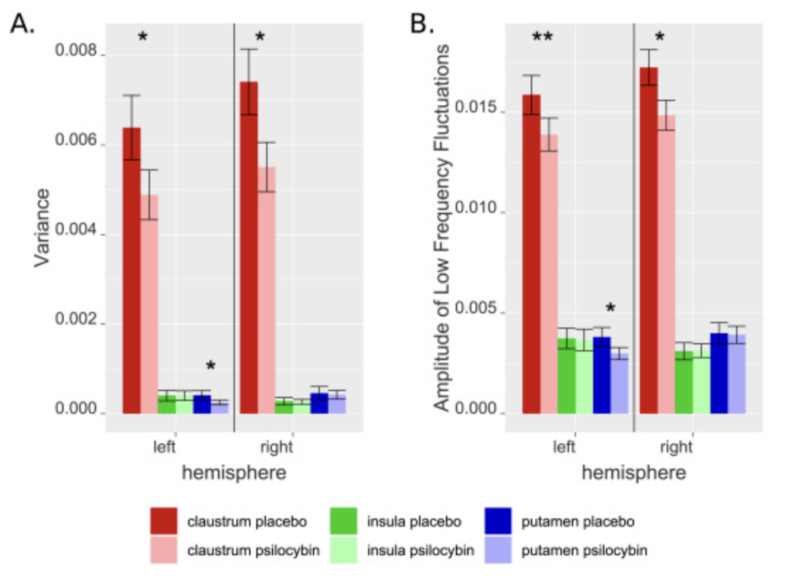
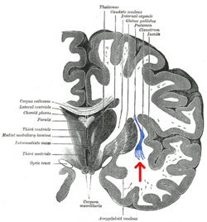
Claustrum
https://www.sciencedirect.com/science/article/pii/S1053811920304663?via%3Dihub
https://en.wikipedia.org/wiki/Claustrum

Slide 17
Can psychedelics be used to treat Alzheimer’s?
Credit: Spotify
Play from 0:35:45 to 0:36:45
Link to full episode:
https://open.spotify.com/episode/04O1q0t4aBhLLYgcZpT7TM?si=nvOr15r9TlyYwKIJAPjyAw

